Slide 1

Training
Phone Gap / Cordova
30/06/2014
By S.D.C.O
Team : Web & Mobile Framework

Slide 2
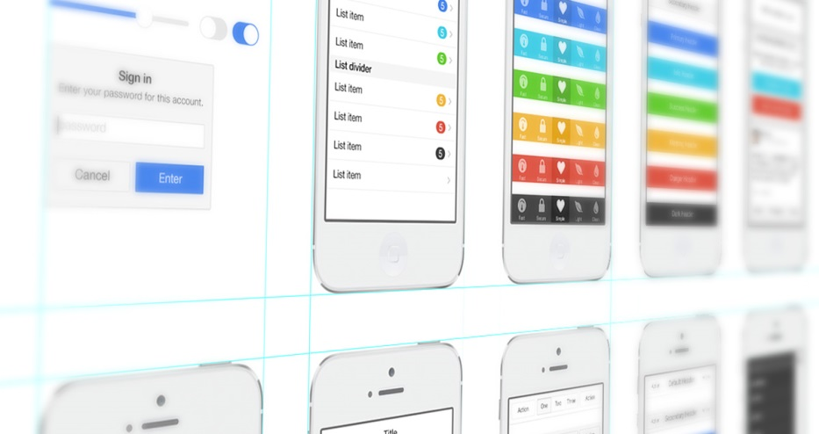
I. About Information
Before please install on your computer :
IDE (WebStrom : http://www.jetbrains.com/webstorm/)
Eclipse ADT (http://developer.android.com/sdk/index.html)
Suject : Develop mobile App with Cordova
Time : One day
Technology :
HTML5
CSS3
JavaScript
Android – IOS
Prerequisites :
Knowledge JavaScript (Framework AngularJS), HTML5 and CSS3.
Basic concepts in Android and IOS
To have a android device for test (else emulator…)
Notes:
1. The first idea that one has when it comes to batch processing is that the processing does not need human interaction.
2. Nothing is waiting until processing end, so we say it is not in real-time
3. The processing involves (generaly) a high volume of informations that involve thousands, hundreds of thousands, or millions of data rows or transactions
4. And there may be complex logic or calculations to perform on the datas
5. So, this processing is computationally expensive, and we don't want this cost to be part of our on-line application
6. We apply the same treatement to all of our data, so it is bulk-oriented
7. As soon as we found in this kind of situation, we decided to run as batch process.
8. Later we will see that these characteristics have a strong impact on the approach we have on the treatment of batches

Slide 3
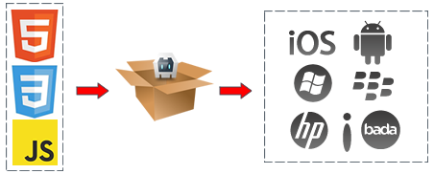
I. What is Phone Gap / Cordova
“PhoneGap is a free and open source framework that allows you to create mobile apps using standardized web APIs for the platforms you care about.”
PhoneGap/Cordova create a Mobile App with
HTML 5
CSS 3
JavaScript
Plugin (GPS, Camera..)
It’s possible :
Android + Javascript
PhoneGap/Cordova create a natif app who open a WebPage inside application
Notes:
1. The first idea that one has when it comes to batch processing is that the processing does not need human interaction.
2. Nothing is waiting until processing end, so we say it is not in real-time
3. The processing involves (generaly) a high volume of informations that involve thousands, hundreds of thousands, or millions of data rows or transactions
4. And there may be complex logic or calculations to perform on the datas
5. So, this processing is computationally expensive, and we don't want this cost to be part of our on-line application
6. We apply the same treatement to all of our data, so it is bulk-oriented
7. As soon as we found in this kind of situation, we decided to run as batch process.
8. Later we will see that these characteristics have a strong impact on the approach we have on the treatment of batches

Slide 4


I. Difference between Phone Gap and Cordova
2009 : Open Source Project by Nitobi (Start-up)
2011 : Acquisition by Adobe
Open source kernel has been given to Apache Software Foundation
Phone Gap is a « Entreprise version »
and
Cordova is a « Community version »
Notes:
1. The first idea that one has when it comes to batch processing is that the processing does not need human interaction.
2. Nothing is waiting until processing end, so we say it is not in real-time
3. The processing involves (generaly) a high volume of informations that involve thousands, hundreds of thousands, or millions of data rows or transactions
4. And there may be complex logic or calculations to perform on the datas
5. So, this processing is computationally expensive, and we don't want this cost to be part of our on-line application
6. We apply the same treatement to all of our data, so it is bulk-oriented
7. As soon as we found in this kind of situation, we decided to run as batch process.
8. Later we will see that these characteristics have a strong impact on the approach we have on the treatment of batches

Slide 5


I. What is Phone Gap / Cordova
Platforms :
Amazon Fire OS
Android
BlackBerry 10
FireFox OS
iOS
Ubuntu OS
Windows Phone
Windows 8
Tizen
Notes:
1. The first idea that one has when it comes to batch processing is that the processing does not need human interaction.
2. Nothing is waiting until processing end, so we say it is not in real-time
3. The processing involves (generaly) a high volume of informations that involve thousands, hundreds of thousands, or millions of data rows or transactions
4. And there may be complex logic or calculations to perform on the datas
5. So, this processing is computationally expensive, and we don't want this cost to be part of our on-line application
6. We apply the same treatement to all of our data, so it is bulk-oriented
7. As soon as we found in this kind of situation, we decided to run as batch process.
8. Later we will see that these characteristics have a strong impact on the approach we have on the treatment of batches

Slide 6
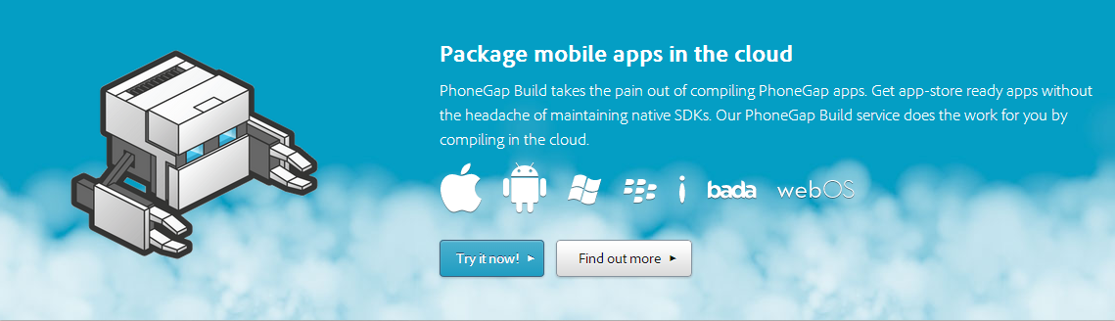
I. Phone Gap Enterprise
Cordova is Free
Adobe : Phone Gap Build
Build automatic your code in Android, IOS, Windows Phone etc etc by the cloud
Notes:
1. The first idea that one has when it comes to batch processing is that the processing does not need human interaction.
2. Nothing is waiting until processing end, so we say it is not in real-time
3. The processing involves (generaly) a high volume of informations that involve thousands, hundreds of thousands, or millions of data rows or transactions
4. And there may be complex logic or calculations to perform on the datas
5. So, this processing is computationally expensive, and we don't want this cost to be part of our on-line application
6. We apply the same treatement to all of our data, so it is bulk-oriented
7. As soon as we found in this kind of situation, we decided to run as batch process.
8. Later we will see that these characteristics have a strong impact on the approach we have on the treatment of batches

Slide 7
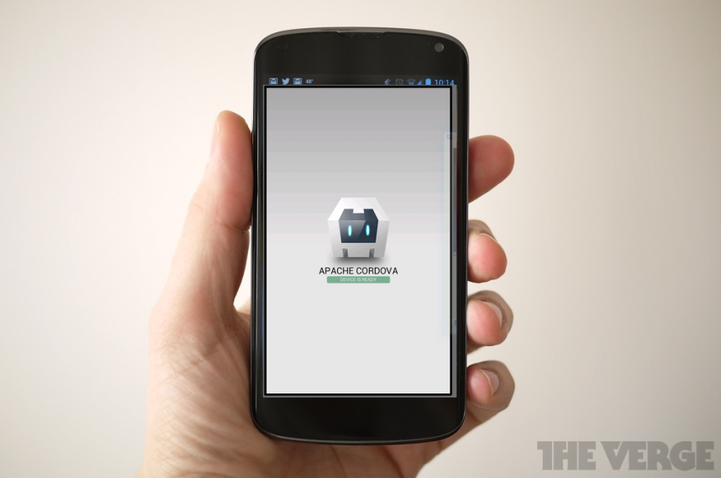
I. Cordova Example
Create projet
cordova create hello com.example.hello Helloworld
Creating a new cordova project with name "Helloworld" and id "com.example.hello" at location "/home/gens/mydev/hello"
Downloading cordova library for www...
Add platform
cordova platform add android
Downloading cordova library for android...
Download complete
Build and launch
cordova build android
cordova run android
For a first automatic build, you can see that
Notes:
1. The first idea that one has when it comes to batch processing is that the processing does not need human interaction.
2. Nothing is waiting until processing end, so we say it is not in real-time
3. The processing involves (generaly) a high volume of informations that involve thousands, hundreds of thousands, or millions of data rows or transactions
4. And there may be complex logic or calculations to perform on the datas
5. So, this processing is computationally expensive, and we don't want this cost to be part of our on-line application
6. We apply the same treatement to all of our data, so it is bulk-oriented
7. As soon as we found in this kind of situation, we decided to run as batch process.
8. Later we will see that these characteristics have a strong impact on the approach we have on the treatment of batches

Slide 8

II. Working Environment
Installation
Proxy
npm config set proxy http://proxy:3128
npm config set https-proxy http://proxy:3128
Node JS : http://nodejs.org/
Run
npm install -g cordova
SDK Android
Java : Add « /bin » to Environnement Path (JAVA_HOME)
Android : Add « /tools » and « /platform-tools » to Path (ANDROID_HOME)
Ant : Add ant to Path (ANT_HOME)
Test in shell with « android » « java » « ant »
If it’s works = it’s ok.
SDK iOS
Launch « Xcode ». Ios librairy automatic installation
Notes:
1. The first idea that one has when it comes to batch processing is that the processing does not need human interaction.
2. Nothing is waiting until processing end, so we say it is not in real-time
3. The processing involves (generaly) a high volume of informations that involve thousands, hundreds of thousands, or millions of data rows or transactions
4. And there may be complex logic or calculations to perform on the datas
5. So, this processing is computationally expensive, and we don't want this cost to be part of our on-line application
6. We apply the same treatement to all of our data, so it is bulk-oriented
7. As soon as we found in this kind of situation, we decided to run as batch process.
8. Later we will see that these characteristics have a strong impact on the approach we have on the treatment of batches

Slide 9


II. Working Environment
Start and structure project
Start a projet
cordova create MonProjet com.atos.hello HelloWorld
Creating a new cordova project with name "HelloWorld" and id "com.atos.hello" at location "/home/gens/mydev/MonProjet"
Downloading cordova library for www...
Folder structure
Hooks : To store a custome commande for cordova
Merges : folder merge with www, example : specific css for android or ios
Platforms: Build for Android, Ios, Windows phone
Plugins : plugins added for your application
www : code html – css – javascript – picture etc
Config.xml : Configuration file for your app (fullscreen, version number etc)
Notes:
1. The first idea that one has when it comes to batch processing is that the processing does not need human interaction.
2. Nothing is waiting until processing end, so we say it is not in real-time
3. The processing involves (generaly) a high volume of informations that involve thousands, hundreds of thousands, or millions of data rows or transactions
4. And there may be complex logic or calculations to perform on the datas
5. So, this processing is computationally expensive, and we don't want this cost to be part of our on-line application
6. We apply the same treatement to all of our data, so it is bulk-oriented
7. As soon as we found in this kind of situation, we decided to run as batch process.
8. Later we will see that these characteristics have a strong impact on the approach we have on the treatment of batches

Slide 10
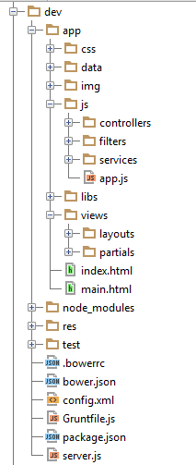
II. Working Environment
www folder content
HTML
CSS
JavaScript
Test
Ressources
Config file (Bower, Grunt, Package…)
It’s a SPA application
Sinple Page Application Principle
Web app with a unique page
Web Page build dunamically
Notes:
1. The first idea that one has when it comes to batch processing is that the processing does not need human interaction.
2. Nothing is waiting until processing end, so we say it is not in real-time
3. The processing involves (generaly) a high volume of informations that involve thousands, hundreds of thousands, or millions of data rows or transactions
4. And there may be complex logic or calculations to perform on the datas
5. So, this processing is computationally expensive, and we don't want this cost to be part of our on-line application
6. We apply the same treatement to all of our data, so it is bulk-oriented
7. As soon as we found in this kind of situation, we decided to run as batch process.
8. Later we will see that these characteristics have a strong impact on the approach we have on the treatment of batches

Slide 11
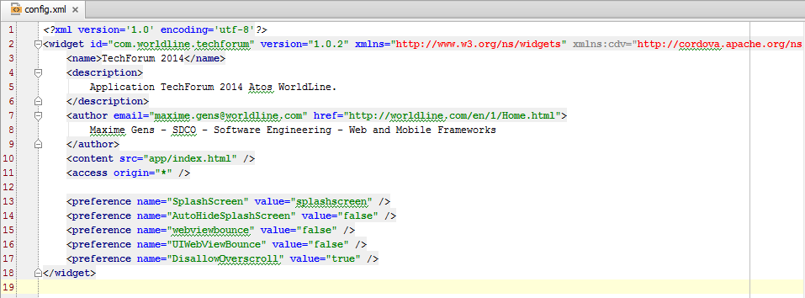
II. Working Environment
Config.xml
Very Important file– Cordova don’t work unless config.xml
Configuration plugins
Configuration : app name - app version
Often modify for each platform (Android – Ios)
Notes:
1. The first idea that one has when it comes to batch processing is that the processing does not need human interaction.
2. Nothing is waiting until processing end, so we say it is not in real-time
3. The processing involves (generaly) a high volume of informations that involve thousands, hundreds of thousands, or millions of data rows or transactions
4. And there may be complex logic or calculations to perform on the datas
5. So, this processing is computationally expensive, and we don't want this cost to be part of our on-line application
6. We apply the same treatement to all of our data, so it is bulk-oriented
7. As soon as we found in this kind of situation, we decided to run as batch process.
8. Later we will see that these characteristics have a strong impact on the approach we have on the treatment of batches

Slide 12
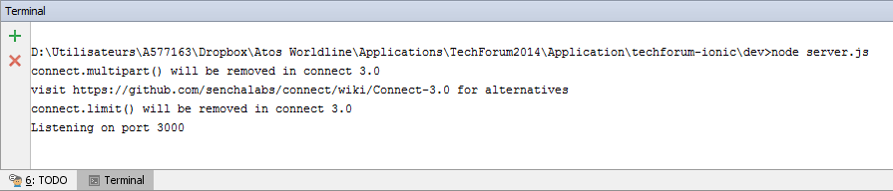
II. Working Environment
Localhost server
If you want working on localhost
/** * Node server for Worldline TechForum 2014 */
var express = require('express');
var app = express();
var maxAge = 31557600000;
app.use(express.compress());
app.use(express.bodyParser());
app.use(express.methodOverride());
app.use(express.static(__dirname + '/' ));
app.get('/*', function(req,res){
res.sendfile(__dirname + '/index.html'); });
app.listen(3000);
console.log('Listening on port 3000');
Use NodeJS server
D:\MonHelloWorld\www> npm init
Add in package.json
"devDependencies": {
"express": "^3.4.8",
"karma": "^0.12.16"
}
Example server.js
Launch NodeJS server : « node server.js »

Slide 13
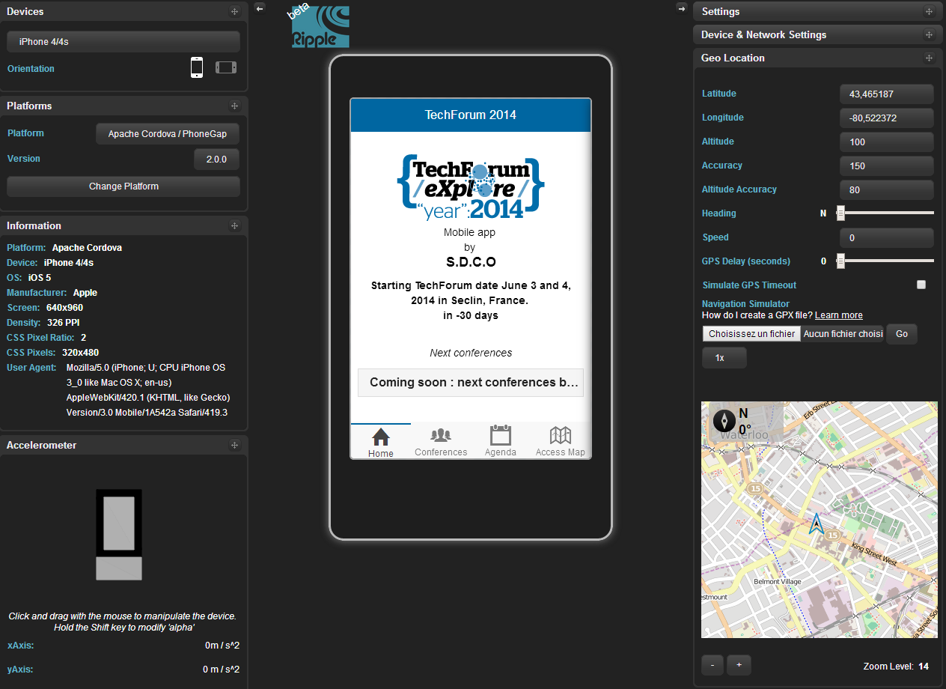
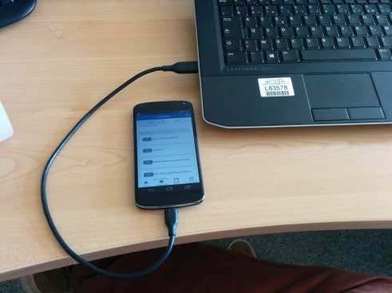
II. Working Environment
How to launch you app
Ripple emultor :
Google Chrome extension
Emule a device environnement
Mainly for visual performance
Old and not update
A real device
Need build
Android Emulator
Need build
The best choice :
Use a real device
Ripple
https://chrome.google.com/webstore/detail/ripple-emulator-beta/geelfhphabnejjhdalkjhgipohgpdnoc
Notes:
1. The first idea that one has when it comes to batch processing is that the processing does not need human interaction.
2. Nothing is waiting until processing end, so we say it is not in real-time
3. The processing involves (generaly) a high volume of informations that involve thousands, hundreds of thousands, or millions of data rows or transactions
4. And there may be complex logic or calculations to perform on the datas
5. So, this processing is computationally expensive, and we don't want this cost to be part of our on-line application
6. We apply the same treatement to all of our data, so it is bulk-oriented
7. As soon as we found in this kind of situation, we decided to run as batch process.
8. Later we will see that these characteristics have a strong impact on the approach we have on the treatment of batches

Slide 14

III. Cordova Plugins
http://plugins.cordova.io/#/
API plugin Cordova
269 plugins :
Device
Console
File
Network-information
Dialogs
Camera
Splashscreen
Geolocalisation
Globalization
Vibration
StatusBar
…
Use a device native functionnality with cordova
How to call a camera, GPS in JavaScript
API Plugin
Possible to create your plugins
Notes:
1. The first idea that one has when it comes to batch processing is that the processing does not need human interaction.
2. Nothing is waiting until processing end, so we say it is not in real-time
3. The processing involves (generaly) a high volume of informations that involve thousands, hundreds of thousands, or millions of data rows or transactions
4. And there may be complex logic or calculations to perform on the datas
5. So, this processing is computationally expensive, and we don't want this cost to be part of our on-line application
6. We apply the same treatement to all of our data, so it is bulk-oriented
7. As soon as we found in this kind of situation, we decided to run as batch process.
8. Later we will see that these characteristics have a strong impact on the approach we have on the treatment of batches

Slide 15
III. Cordova Plugins
Installation plugin
cordova plugin add org.apache..vibration
Fetching plugin "org.apache.cordova.vibration" via plugin registry
Installing "org.apache.cordova.vibration" for android
Add in your JavaScript
navigator.notification.vibrate(time)
Consult documentation to use plugin
If you use plugin with worldline proxy
Donwload .zip plugin file on Github. For example
https://github.com/apache/cordova-plugin-splashscreen
https://github.com/apache/cordova-plugin-geolocation
https://github.com/apache/cordova-plugin-network-information
Extracts and install plugins
cordova plugin add [pathtotheextractedplugingit]cordova-plugin-geolocation-master
cordova plugin add [pathtotheextractedplugingit]cordova-plugin-splashscreen-master
Notes:
1. The first idea that one has when it comes to batch processing is that the processing does not need human interaction.
2. Nothing is waiting until processing end, so we say it is not in real-time
3. The processing involves (generaly) a high volume of informations that involve thousands, hundreds of thousands, or millions of data rows or transactions
4. And there may be complex logic or calculations to perform on the datas
5. So, this processing is computationally expensive, and we don't want this cost to be part of our on-line application
6. We apply the same treatement to all of our data, so it is bulk-oriented
7. As soon as we found in this kind of situation, we decided to run as batch process.
8. Later we will see that these characteristics have a strong impact on the approach we have on the treatment of batches

Slide 16
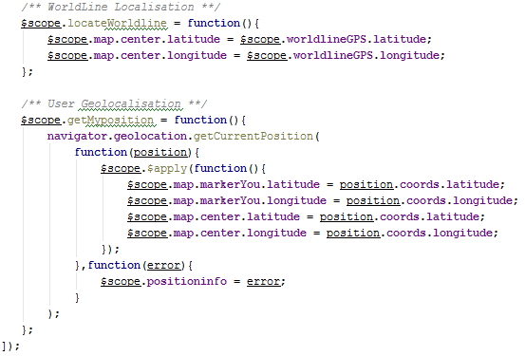
III. Cordova Plugins
Example
https://github.com/apache/cordova-plugin-geolocation/
Cordova GPS Plugin
Use a Apply() for update interface
Notes:
1. The first idea that one has when it comes to batch processing is that the processing does not need human interaction.
2. Nothing is waiting until processing end, so we say it is not in real-time
3. The processing involves (generaly) a high volume of informations that involve thousands, hundreds of thousands, or millions of data rows or transactions
4. And there may be complex logic or calculations to perform on the datas
5. So, this processing is computationally expensive, and we don't want this cost to be part of our on-line application
6. We apply the same treatement to all of our data, so it is bulk-oriented
7. As soon as we found in this kind of situation, we decided to run as batch process.
8. Later we will see that these characteristics have a strong impact on the approach we have on the treatment of batches

Slide 17
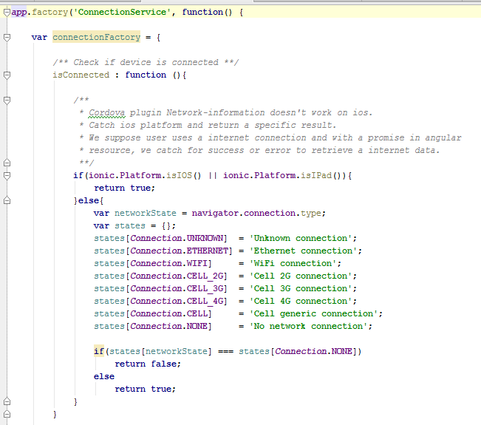
III. Cordova Plugins
Example
https://github.com/apache/cordova-plugin-network-information
Cordova network Information Plugin
Good Practice :
Use a Angular Service to call this fonctionality
Only IOS and
Windows Phone
iOS and Windows Phone can't detect the type of cellular network connection.
Notes:
1. The first idea that one has when it comes to batch processing is that the processing does not need human interaction.
2. Nothing is waiting until processing end, so we say it is not in real-time
3. The processing involves (generaly) a high volume of informations that involve thousands, hundreds of thousands, or millions of data rows or transactions
4. And there may be complex logic or calculations to perform on the datas
5. So, this processing is computationally expensive, and we don't want this cost to be part of our on-line application
6. We apply the same treatement to all of our data, so it is bulk-oriented
7. As soon as we found in this kind of situation, we decided to run as batch process.
8. Later we will see that these characteristics have a strong impact on the approach we have on the treatment of batches

Slide 18

III. Cordova Plugins
Ng-Cordova
App Ng-Cordova
Cordova with the power of AngularJS
ngCordova is a set of AngularJS extensions on top of the Cordova API to make it easier to build, test, and deploy Cordova apps with AngularJS.
Version Alpha v0.1.3
There not all plugin
Easy to use a simply plugin
Official webSite
http://ngcordova.com/
Demo app by S.D.C.O – Web & Mobile Framework
https://github.com/got5/ngCordova-demo

Slide 19

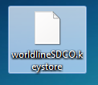

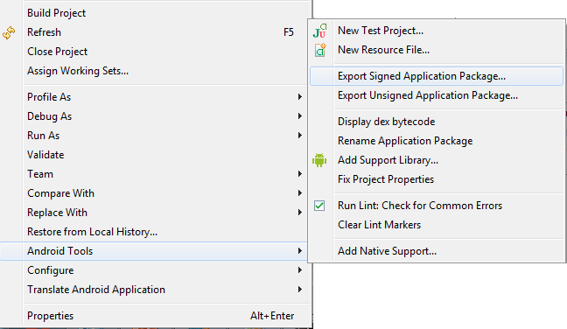
IV. Deploy your app
Android
You app should be signed !
KeyStore
Alias of your app
Password of your app
Country
…
worldlineSDCO.keystore
alias
alias
alias
alias
techforum
ng-cordova
app 3
app 4
It’s very easy on Android
Keystore organisation
How to sign a app with Eclipse
Follow indications
Create a keystore
Create a alias
…
Notes:
1. The first idea that one has when it comes to batch processing is that the processing does not need human interaction.
2. Nothing is waiting until processing end, so we say it is not in real-time
3. The processing involves (generaly) a high volume of informations that involve thousands, hundreds of thousands, or millions of data rows or transactions
4. And there may be complex logic or calculations to perform on the datas
5. So, this processing is computationally expensive, and we don't want this cost to be part of our on-line application
6. We apply the same treatement to all of our data, so it is bulk-oriented
7. As soon as we found in this kind of situation, we decided to run as batch process.
8. Later we will see that these characteristics have a strong impact on the approach we have on the treatment of batches

Slide 20
IV. Deploy your app
Android
Generate keystore on commande line
D:\A******\>keytool -genkey -alias worldlineSDCO -keyalg RSA -keystore worldlineSDCO.keystore -keysize 2048 -validity 10000
Entrez le mot de passe du fichier de clÚs :
Ressaisissez le nouveau mot de passe :
Quels sont vos nom et prÚnom ?
[Unknown]: Maxime Gens
Quel est le nom de votre unitÚ organisationnelle ?
[Unknown]: SDCO - Web and Mobile framework
Quel est le nom de votre entreprise ?
[Unknown]: Wordline
Quel est le nom de votre ville de rÚsidence ?
[Unknown]: Seclin
Quel est le nom de votre Útat ou province ?
[Unknown]: Nord-Pas-de-Calais
Quel est le code pays Ó deux lettres pour cette unitÚ ?
[Unknown]: fr
Est-ce CN=Maxime Gens, OU=SDCO - Web and Mobile framework, O=Wordline, L=Seclin, ST=Nord-Pas-de-Calais, C=fr ?
[non]: oui
Entrez le mot de passe de la clÚ pour <worldlineSDCO>
(appuyez sur EntrÚe s'il s'agit du mot de passe du fichier de clÚs) :
Notes:
1. The first idea that one has when it comes to batch processing is that the processing does not need human interaction.
2. Nothing is waiting until processing end, so we say it is not in real-time
3. The processing involves (generaly) a high volume of informations that involve thousands, hundreds of thousands, or millions of data rows or transactions
4. And there may be complex logic or calculations to perform on the datas
5. So, this processing is computationally expensive, and we don't want this cost to be part of our on-line application
6. We apply the same treatement to all of our data, so it is bulk-oriented
7. As soon as we found in this kind of situation, we decided to run as batch process.
8. Later we will see that these characteristics have a strong impact on the approach we have on the treatment of batches

Slide 21
IV. Deploy your app
Android
Sign app on commande line
D:\A******\Desktop>jarsigner -verbose -keystore worldlineSDCO.keystore techforum.apk worldlineSDCO
Enter Passphrase for keystore:
…
jar signed.
If you use Java 7
1 | jarsigner -verbose -keystore <name_du_keystore.keystore> <name_apk.apk> <alias>
Else
1 | jarsigner -verbose -sigalg SHA1withRSA -digestalg SHA1 -keystore <name_du_keystore.keystore> <name_apk.apk> <alias>
<name_keystore.keystore> : keystore name use to sign app
<name_apk.apk> : apk name to sign
<alias> : key name in keystore
Notes:
1. The first idea that one has when it comes to batch processing is that the processing does not need human interaction.
2. Nothing is waiting until processing end, so we say it is not in real-time
3. The processing involves (generaly) a high volume of informations that involve thousands, hundreds of thousands, or millions of data rows or transactions
4. And there may be complex logic or calculations to perform on the datas
5. So, this processing is computationally expensive, and we don't want this cost to be part of our on-line application
6. We apply the same treatement to all of our data, so it is bulk-oriented
7. As soon as we found in this kind of situation, we decided to run as batch process.
8. Later we will see that these characteristics have a strong impact on the approach we have on the treatment of batches

Slide 22


IV. Deploy your app
Ios
You shoud have a two certificats
Develper Certificate
Test your app
Run a ios simulateur
Run app on real ios device
Distribution Certificate
Sign your app
Publish on Apple Store or In-house Store
Create a official version
Run Official version on all ios device
Notes:
1. The first idea that one has when it comes to batch processing is that the processing does not need human interaction.
2. Nothing is waiting until processing end, so we say it is not in real-time
3. The processing involves (generaly) a high volume of informations that involve thousands, hundreds of thousands, or millions of data rows or transactions
4. And there may be complex logic or calculations to perform on the datas
5. So, this processing is computationally expensive, and we don't want this cost to be part of our on-line application
6. We apply the same treatement to all of our data, so it is bulk-oriented
7. As soon as we found in this kind of situation, we decided to run as batch process.
8. Later we will see that these characteristics have a strong impact on the approach we have on the treatment of batches

Slide 23
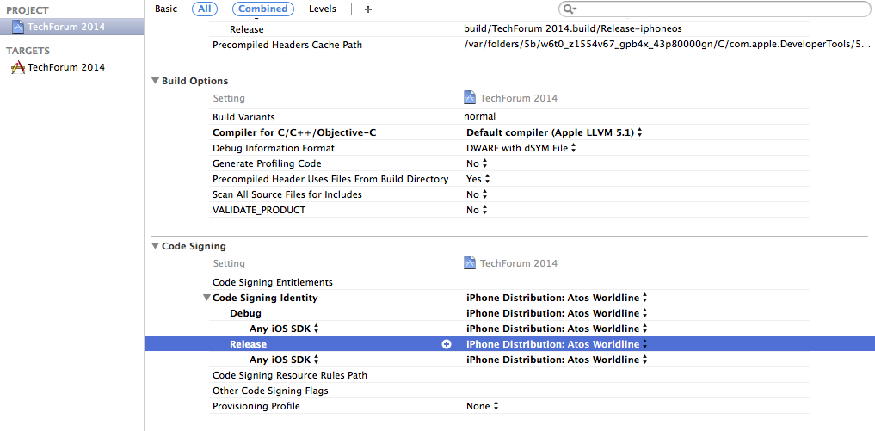
IV. Deploy your app
Ios
How to sign with distribution Certificate
Select your production certificate on your project : « Build Settings » and « Code signing »
Notes:
1. The first idea that one has when it comes to batch processing is that the processing does not need human interaction.
2. Nothing is waiting until processing end, so we say it is not in real-time
3. The processing involves (generaly) a high volume of informations that involve thousands, hundreds of thousands, or millions of data rows or transactions
4. And there may be complex logic or calculations to perform on the datas
5. So, this processing is computationally expensive, and we don't want this cost to be part of our on-line application
6. We apply the same treatement to all of our data, so it is bulk-oriented
7. As soon as we found in this kind of situation, we decided to run as batch process.
8. Later we will see that these characteristics have a strong impact on the approach we have on the treatment of batches

Slide 24
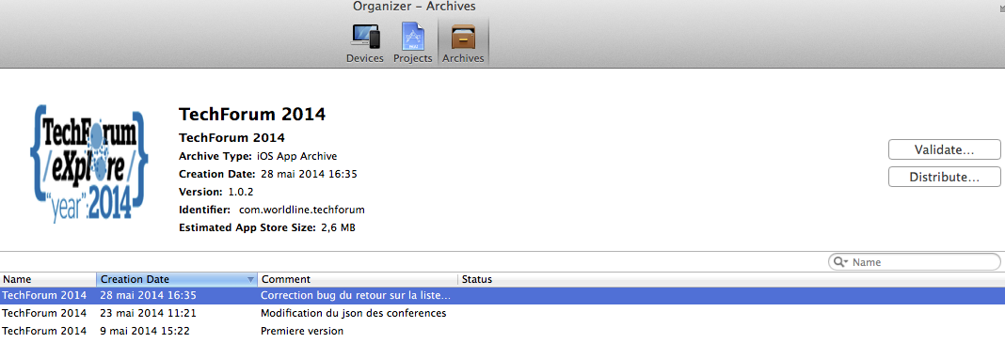
IV. Deploy your app
Ios
Generate a « archive » by « Product »
In « Windows » select « organiser » and « Distribute » on your app for create a IPA
IPA is your binary application ( like APK on Android)
Notes:
1. The first idea that one has when it comes to batch processing is that the processing does not need human interaction.
2. Nothing is waiting until processing end, so we say it is not in real-time
3. The processing involves (generaly) a high volume of informations that involve thousands, hundreds of thousands, or millions of data rows or transactions
4. And there may be complex logic or calculations to perform on the datas
5. So, this processing is computationally expensive, and we don't want this cost to be part of our on-line application
6. We apply the same treatement to all of our data, so it is bulk-oriented
7. As soon as we found in this kind of situation, we decided to run as batch process.
8. Later we will see that these characteristics have a strong impact on the approach we have on the treatment of batches

Slide 25
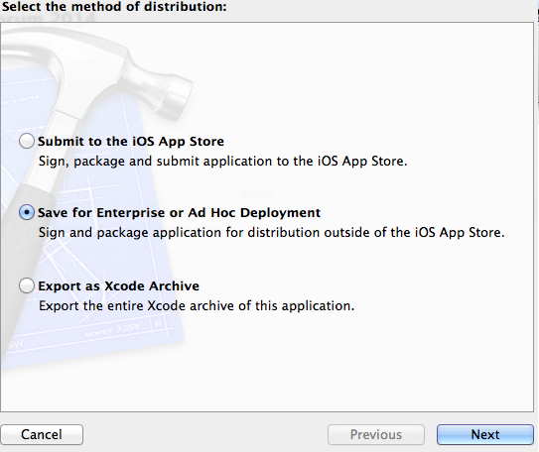
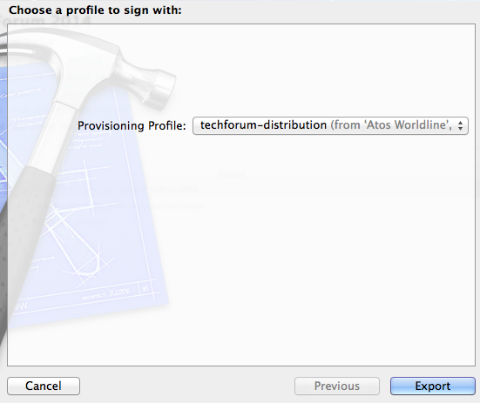

IV. Deploy your app
Ios
Select your method of distribution
Selection your profile
You have now generate IPA
Notes:
1. The first idea that one has when it comes to batch processing is that the processing does not need human interaction.
2. Nothing is waiting until processing end, so we say it is not in real-time
3. The processing involves (generaly) a high volume of informations that involve thousands, hundreds of thousands, or millions of data rows or transactions
4. And there may be complex logic or calculations to perform on the datas
5. So, this processing is computationally expensive, and we don't want this cost to be part of our on-line application
6. We apply the same treatement to all of our data, so it is bulk-oriented
7. As soon as we found in this kind of situation, we decided to run as batch process.
8. Later we will see that these characteristics have a strong impact on the approach we have on the treatment of batches

Slide 26
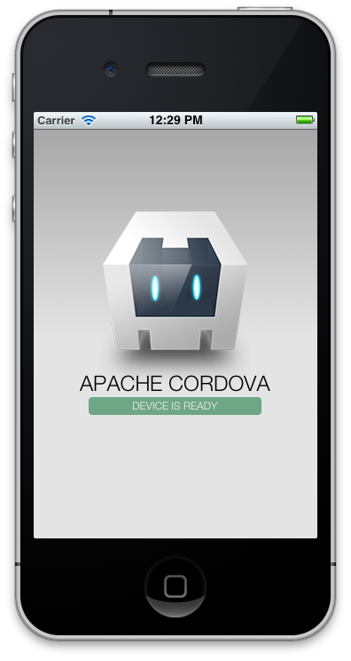


V. Hello World
Steps :
Create a cordova project
Add platform (Android – Ios …)
Build
Run (Open android project with eclipse and run emulator)
Sign
You can see
On real device (or emulator)
On localhost
Notes:
1. The first idea that one has when it comes to batch processing is that the processing does not need human interaction.
2. Nothing is waiting until processing end, so we say it is not in real-time
3. The processing involves (generaly) a high volume of informations that involve thousands, hundreds of thousands, or millions of data rows or transactions
4. And there may be complex logic or calculations to perform on the datas
5. So, this processing is computationally expensive, and we don't want this cost to be part of our on-line application
6. We apply the same treatement to all of our data, so it is bulk-oriented
7. As soon as we found in this kind of situation, we decided to run as batch process.
8. Later we will see that these characteristics have a strong impact on the approach we have on the treatment of batches

Slide 27



VI. Mobile JavaScript Framework
Sencha Touch
Launch v 1.0 in 2010
HTML5 - JavaScript
MVC – Objet (Like .NET and Java)
Popular and to use by a several big entreprise
More 1 millions user
Leader
Famo.us
New on market
Free and Open-Source
3D UI with HTML5 and CSS3
Hardware acceleration
Ionic
New on market ( Octobre 2013 )
AngularJS – Performance
Composant Javascript
Hight potential
Notes:
1. The first idea that one has when it comes to batch processing is that the processing does not need human interaction.
2. Nothing is waiting until processing end, so we say it is not in real-time
3. The processing involves (generaly) a high volume of informations that involve thousands, hundreds of thousands, or millions of data rows or transactions
4. And there may be complex logic or calculations to perform on the datas
5. So, this processing is computationally expensive, and we don't want this cost to be part of our on-line application
6. We apply the same treatement to all of our data, so it is bulk-oriented
7. As soon as we found in this kind of situation, we decided to run as batch process.
8. Later we will see that these characteristics have a strong impact on the approach we have on the treatment of batches

Slide 28
VII. Ionic
Introduction and make a application with Ionic Framework
Notes:
1. The first idea that one has when it comes to batch processing is that the processing does not need human interaction.
2. Nothing is waiting until processing end, so we say it is not in real-time
3. The processing involves (generaly) a high volume of informations that involve thousands, hundreds of thousands, or millions of data rows or transactions
4. And there may be complex logic or calculations to perform on the datas
5. So, this processing is computationally expensive, and we don't want this cost to be part of our on-line application
6. We apply the same treatement to all of our data, so it is bulk-oriented
7. As soon as we found in this kind of situation, we decided to run as batch process.
8. Later we will see that these characteristics have a strong impact on the approach we have on the treatment of batches

Slide 29


VII. Introduction Ionic
http://ionicframework.com/
Open source front-end framework for developing hybrid mobile apps with HTML5
Create hydride mobile application with web technology
Use Phone Gap / Cordova
Call a device fonctionality with API Apache (GPS…)
Web development environnement
Framework JavaScript and CSS
Very fast mobile app (hight level performance)
Recent Framework
November 2009
Beta version 1.0
Advice against for inferior device Android 4.1 and IOS 6
Notes:
1. The first idea that one has when it comes to batch processing is that the processing does not need human interaction.
2. Nothing is waiting until processing end, so we say it is not in real-time
3. The processing involves (generaly) a high volume of informations that involve thousands, hundreds of thousands, or millions of data rows or transactions
4. And there may be complex logic or calculations to perform on the datas
5. So, this processing is computationally expensive, and we don't want this cost to be part of our on-line application
6. We apply the same treatement to all of our data, so it is bulk-oriented
7. As soon as we found in this kind of situation, we decided to run as batch process.
8. Later we will see that these characteristics have a strong impact on the approach we have on the treatment of batches

Slide 30

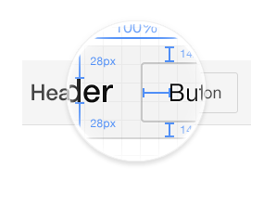


VII. Introduction Ionic
Ionic Objectifs
Performance Obsession
Optimized for Angular JS
Pleasant and modern design
Very potential framework
Active forum
Angular is JavaScript Framwork developed by Google
Link
http://ionicframework.com/docs/
http://codepen.io/ionic/pen/zkmhJ
http://ionicons.com/
Notes:
1. The first idea that one has when it comes to batch processing is that the processing does not need human interaction.
2. Nothing is waiting until processing end, so we say it is not in real-time
3. The processing involves (generaly) a high volume of informations that involve thousands, hundreds of thousands, or millions of data rows or transactions
4. And there may be complex logic or calculations to perform on the datas
5. So, this processing is computationally expensive, and we don't want this cost to be part of our on-line application
6. We apply the same treatement to all of our data, so it is bulk-oriented
7. As soon as we found in this kind of situation, we decided to run as batch process.
8. Later we will see that these characteristics have a strong impact on the approach we have on the treatment of batches

Slide 31

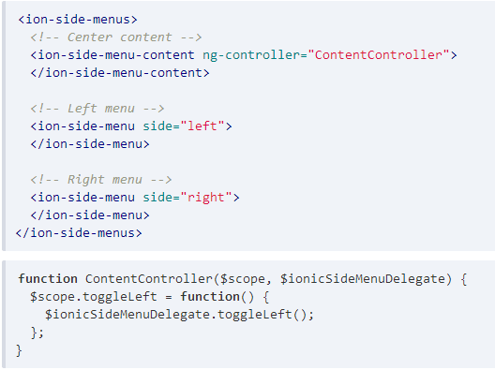
VII. Demonstration Ionic
SlideMenu

Slide 32

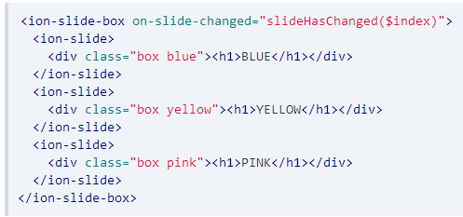
VII. Demonstration Ionic
Slidebox

Slide 33

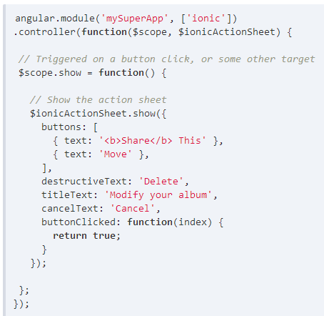
VII. Demonstration Ionic
ActionSheet

Slide 34
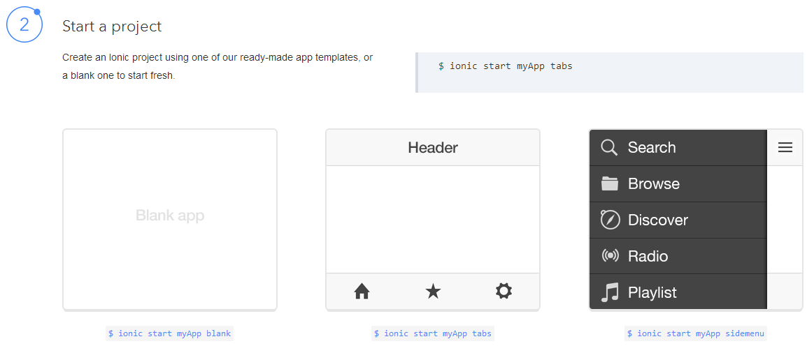
VII. Demonstration Ionic
Start a Ionic project

Slide 35
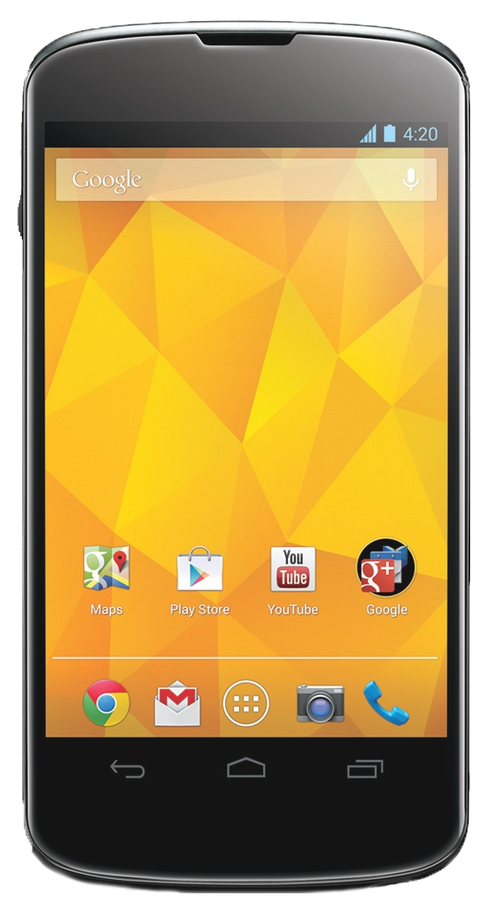

VIII. TechForum eXplore 2014 App
Mobile app for Techforum 2014 event in Worldline
Cordova app build with Ionic framework ( version beta 1.0-4)
To do
Import and install Ionic with bower
Create Ion-Tab
Implement conferences list with ion-list
Implement Popup and loader with IonicPopup, ionicLoading
Integration GPS Plugin
Deploy on Android
Technology and utils
Ionic
Cordova Plugin (GPS, Network Information, SplashScreen )
HTML5 - CSS3 – AngularJS
Bower – Grunt
NodeJS
Ripple – Nexus 4 device
PhotoFiltre
Notes:
1. The first idea that one has when it comes to batch processing is that the processing does not need human interaction.
2. Nothing is waiting until processing end, so we say it is not in real-time
3. The processing involves (generaly) a high volume of informations that involve thousands, hundreds of thousands, or millions of data rows or transactions
4. And there may be complex logic or calculations to perform on the datas
5. So, this processing is computationally expensive, and we don't want this cost to be part of our on-line application
6. We apply the same treatement to all of our data, so it is bulk-oriented
7. As soon as we found in this kind of situation, we decided to run as batch process.
8. Later we will see that these characteristics have a strong impact on the approach we have on the treatment of batches

Slide 36

IIX. Application Advancement
Import and install Ionic with bower
D:\A******\MonProjet >npm install
D:\A******\MonProjet >bower init
D:\A******\MonProjet >bower install ionic#1.0.0-beta.4 --save
Create a .bowerrc
Install with bower
Ionic ( 1.0.0-beta.4)
angular-ressoure (1.2.20)
angular-google-maps (1.0.17)
Include in main.html
File .bowerrc
{
"directory": "app/libs",
"json": "bower.json"
}
Don’t forget to include
<!-- Ionic -->
<link rel="stylesheet" href="libs/ionic/release/css/ionic.min.css">
<script src="libs/ionic/release/js/ionic.bundle.min.js"></script>
https://github.com/driftyco/ionic
https://github.com/angular/bower-angular-resource
http://angular-google-maps.org/
Notes:
1. The first idea that one has when it comes to batch processing is that the processing does not need human interaction.
2. Nothing is waiting until processing end, so we say it is not in real-time
3. The processing involves (generaly) a high volume of informations that involve thousands, hundreds of thousands, or millions of data rows or transactions
4. And there may be complex logic or calculations to perform on the datas
5. So, this processing is computationally expensive, and we don't want this cost to be part of our on-line application
6. We apply the same treatement to all of our data, so it is bulk-oriented
7. As soon as we found in this kind of situation, we decided to run as batch process.
8. Later we will see that these characteristics have a strong impact on the approach we have on the treatment of batches

Slide 37

IIX. Application Advancement
2. Create ion-tabs
Modify a follow files
App.js :
add a correct route to display tabs (use templateUrl)
Tabs.html :
add a ion-tab with title and icon
add a ion-nav-view in ion-tab
Ion-tab attributs
Conference
Title : Conferences
Icon : ion-ios7-people
Href : #/tab/conferences
Ion-nav-view : conferences-tab
Agenda
Title : Agenda
Icon : ion-calendar
Href : #/tab/agenda
Ion-nav-view : agenda-tab
Ion-tabs
List Ionic icon : http://ionicons.com/
Notes:
1. The first idea that one has when it comes to batch processing is that the processing does not need human interaction.
2. Nothing is waiting until processing end, so we say it is not in real-time
3. The processing involves (generaly) a high volume of informations that involve thousands, hundreds of thousands, or millions of data rows or transactions
4. And there may be complex logic or calculations to perform on the datas
5. So, this processing is computationally expensive, and we don't want this cost to be part of our on-line application
6. We apply the same treatement to all of our data, so it is bulk-oriented
7. As soon as we found in this kind of situation, we decided to run as batch process.
8. Later we will see that these characteristics have a strong impact on the approach we have on the treatment of batches

Slide 38
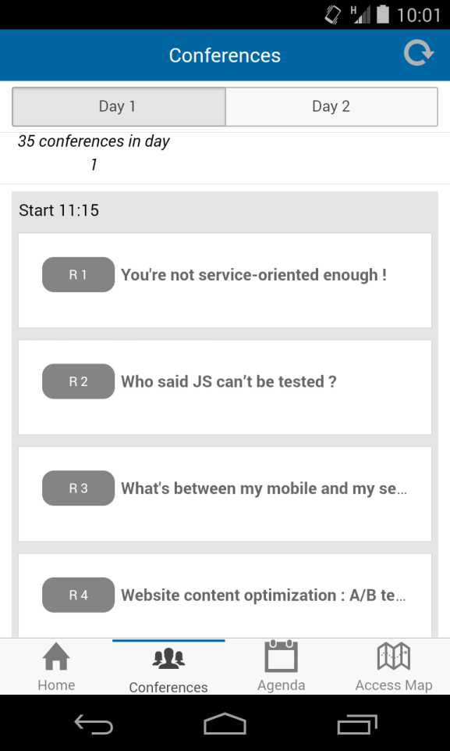
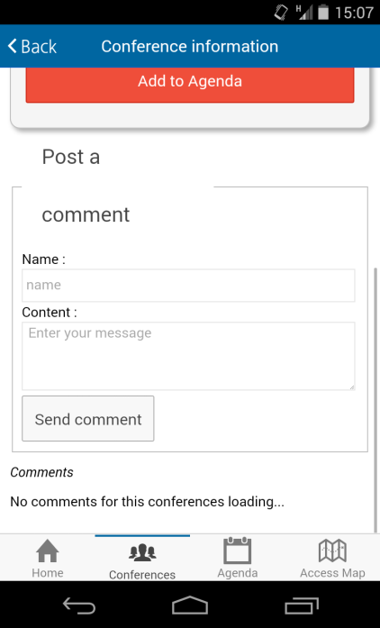
IIX. Application Advancement
3. Implement conferences list with ion-list
Modify a follow files
Conferences.html
Add <ion-item> with ng-repeat on conferences ( filtre : | scheduleByConference:itemSchedule:search.day | orderBy:'where‘) and when click on a item, call displayConference method
Detail_conference.html
Implement a ion-list : for display comments
Ion-list
Post a comment
Notes:
1. The first idea that one has when it comes to batch processing is that the processing does not need human interaction.
2. Nothing is waiting until processing end, so we say it is not in real-time
3. The processing involves (generaly) a high volume of informations that involve thousands, hundreds of thousands, or millions of data rows or transactions
4. And there may be complex logic or calculations to perform on the datas
5. So, this processing is computationally expensive, and we don't want this cost to be part of our on-line application
6. We apply the same treatement to all of our data, so it is bulk-oriented
7. As soon as we found in this kind of situation, we decided to run as batch process.
8. Later we will see that these characteristics have a strong impact on the approach we have on the treatment of batches

Slide 39
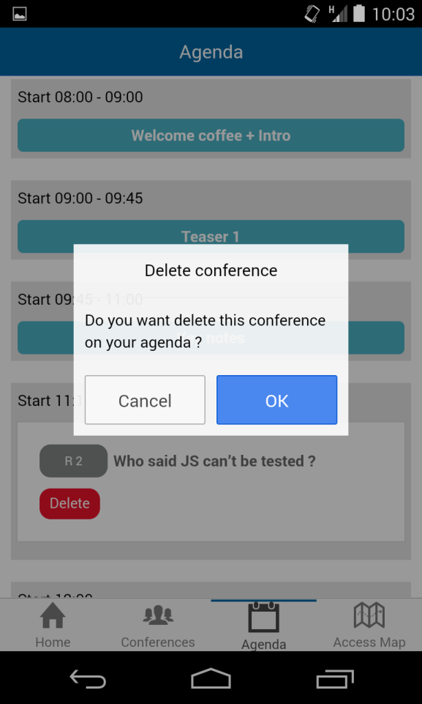
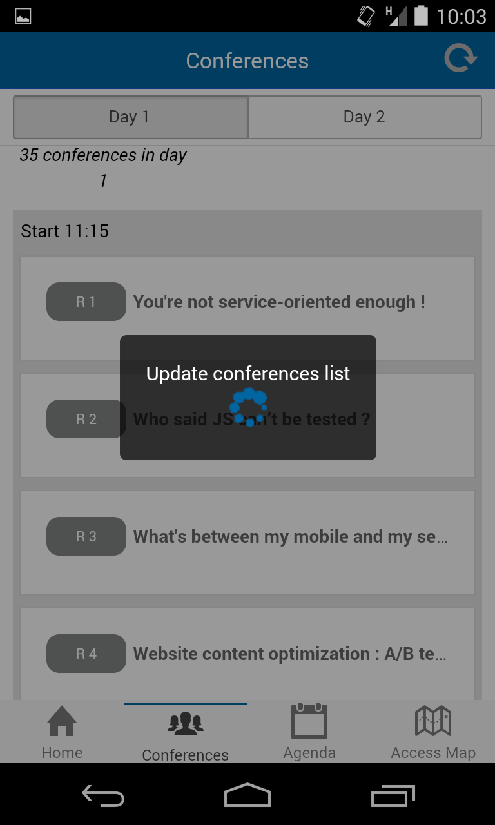
IIX. Application Advancement
4. Implement Popup with IonicPopup
Modify a follow files
AgendaController.js
Add IonicPopup add a confirmPopup with ionic
for delete a conference in agenda
ConferencesControllers.js
Add ionic Popup : add a alert when internet is disable on a updateConference method
Add a ionicLoader add a loading for retreive a conference list and don’t forget to hide after success of retreive ( use « atos-loader.gif » in « img » folder)
http://ionicframework.com/docs/api/service/$ionicPopup/
http://ionicframework.com/docs/api/service/$ionicLoading/
IonicConfirm
IonicLoader
Notes:
1. The first idea that one has when it comes to batch processing is that the processing does not need human interaction.
2. Nothing is waiting until processing end, so we say it is not in real-time
3. The processing involves (generaly) a high volume of informations that involve thousands, hundreds of thousands, or millions of data rows or transactions
4. And there may be complex logic or calculations to perform on the datas
5. So, this processing is computationally expensive, and we don't want this cost to be part of our on-line application
6. We apply the same treatement to all of our data, so it is bulk-oriented
7. As soon as we found in this kind of situation, we decided to run as batch process.
8. Later we will see that these characteristics have a strong impact on the approach we have on the treatment of batches

Slide 40
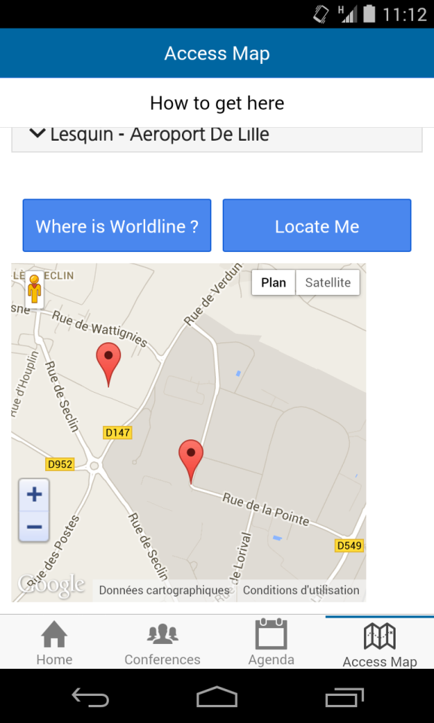

IIX. Application Advancement
5. Integration GPS Plugin
Download and integrate a GPS plugin
Download plugin by Github
Install plugin with .zip if you have a some proxy’s problem
Don’t forget to build for « install » plugin in your app
In AccessController
Implement getMyPosition for update a user currentPosition
Use a apply() to update position on interface
Update map.marker and map.center with a current position
GPS Plugin
Notes:
1. The first idea that one has when it comes to batch processing is that the processing does not need human interaction.
2. Nothing is waiting until processing end, so we say it is not in real-time
3. The processing involves (generaly) a high volume of informations that involve thousands, hundreds of thousands, or millions of data rows or transactions
4. And there may be complex logic or calculations to perform on the datas
5. So, this processing is computationally expensive, and we don't want this cost to be part of our on-line application
6. We apply the same treatement to all of our data, so it is bulk-oriented
7. As soon as we found in this kind of situation, we decided to run as batch process.
8. Later we will see that these characteristics have a strong impact on the approach we have on the treatment of batches

Slide 41

IIX. Application Advancement
6. Deploy on Android
Deploy your app =)
Build
Test (Real device ou emulator – eclipse …)
Create APK
Sign APK
Notes:
1. The first idea that one has when it comes to batch processing is that the processing does not need human interaction.
2. Nothing is waiting until processing end, so we say it is not in real-time
3. The processing involves (generaly) a high volume of informations that involve thousands, hundreds of thousands, or millions of data rows or transactions
4. And there may be complex logic or calculations to perform on the datas
5. So, this processing is computationally expensive, and we don't want this cost to be part of our on-line application
6. We apply the same treatement to all of our data, so it is bulk-oriented
7. As soon as we found in this kind of situation, we decided to run as batch process.
8. Later we will see that these characteristics have a strong impact on the approach we have on the treatment of batches

Slide 42

IIX. Conclusion
You can now
Develop a little application with Cordova/Ionic
Build and deploy a Cordova App
Understand a cordova principe
Cordova / Phonegap is recommanded for
A Little application
A vitrine Application
A simply application
Not for a complex or big app

Slide 43
Thanks
For more information please contact:
maxime.gens@worldline.com
Training create by S.D.C.O – Web & Mobile Framework
30/06/2014

